Slide 1
1

Slide 2
Software Life Cycle Models
The goal of Software Engineering is to provide models and processes that lead to the production of well-documented maintainable software in a manner that is predictable.
2

Slide 3
Software Life Cycle Models
“The period of time that starts when a software product is conceived and ends when the product is no longer available for use. The software life cycle typically includes a requirement phase, design phase, implementation phase, test phase, installation and check out phase, operation and maintenance phase, and sometimes retirement phase”.
3

Slide 4
Software Development Life Cycle
A framework that describes the activities performed at each stage of a software development process
4

Slide 5
Build & Fix Model
Product is constructed without specifications or any attempt at design
Build Code
Adhoc approach and not well defined
Simple two phase model
Fix
5

Slide 6
Build & Fix Model
Suitable for small programming exercises of 100 or 200 lines
Code soon becomes unfixable & unenhanceable
No room for structured design
Maintenance is practically not possible
High Cost
6

Slide 7
Waterfall Model( BY ROYCE)
Requirement Analysis and Specification
This model is named waterfall model because it is diagrammatic representation resembles a cascade of waterfall
SRS doc
Design
SDD doc
Implementation and Unit Testing
Integration and System Testing
Operation and Maintenance

Slide 8
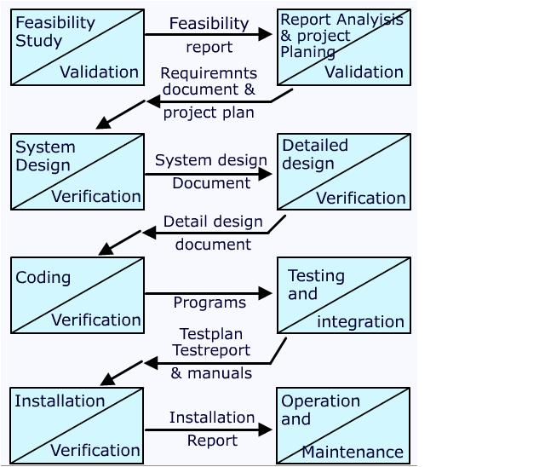
Waterfall Model

Slide 9
Waterfall Model
This model is easy to understand and reinforces the notion of “define before design” and “design before code”.
The model | expects | complete & | accurate
requirements | early in | the process, | which is
unrealistic
9

Slide 10
Waterfall Model
Documents generated by waterfall Model
Requirement Document
Project Plan
Design Document
Test Plan and Test Report
Final Code
Software Manual
Review Report
Status Report
10

Slide 11
Waterfall Model
Advantages/Merits Of Waterfall Model
Simplicity
Clearly defined phases
Well understood milestone
Good for management control
11

Slide 12
Waterfall Model
Problems of waterfall model
It is difficult to define all requirements at the beginning of a project
This model is not suitable for accommodating any change
A working version of the system is not seen until late in the project’s life
It does not scale up well to large projects.
Real projects are rarely sequential
Follow “Big- Bang” Approach.
It is “Document Driven” Process
12

Slide 13
Waterfall Model
When to use Waterfall
Requirements are well understood
Product definition is stable
Technology is understood
New version of existing product
13

Slide 14
Incremental Process Models
They are effective in the situations where requirements are defined precisely and there is no confusion about the functionality of the final product.
After every cycle a useable product is given to the customer.
Popular particularly when we have to quickly deliver a limited functionality system.
14

Slide 15
Iterative Enhancement Model
This model has the same phases as the waterfall model, but with fewer restrictions. Generally the phases occur in the same order as in the waterfall model, but they may be conducted in several cycles. Useable product is released at the end of the each cycle, with each release providing additional functionality.
Customers and developers specify as many requirements as possible and prepare a SRS document.
Developers and customers then prioritize these requirements
Developers implement the specified requirements in one or more cycles of design, implementation and test based on the defined priorities.

Slide 16
Iterative Enhancement Model
Complete product is divided into releases
Developer deliver the product release by release
Customer is able to do useful work after 1st release
1st release available within few weeks

Slide 17
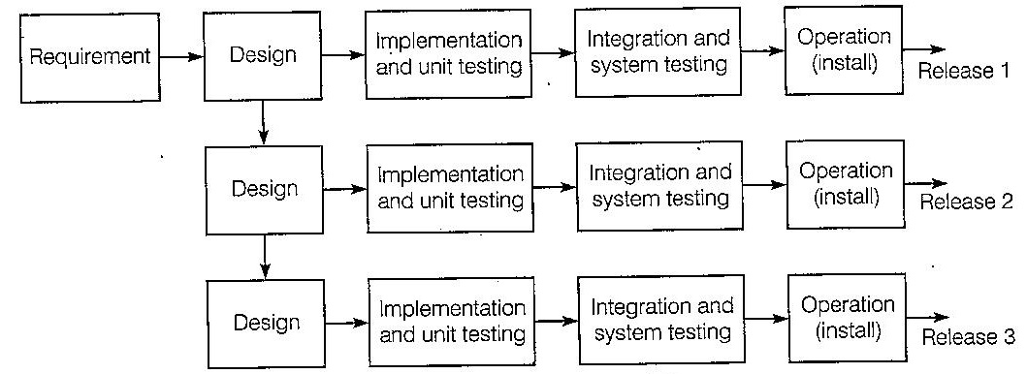
Iterative Enhancement Model

Slide 18
Evolutionary Process Models
Evolutionary process model resembles iterative enhancement model. The same phases as defined for the waterfall model occur here in a cyclical fashion. This model differs from iterative enhancement model in the sense that this does not require a useable product at the end of each cycle. In evolutionary development, requirements are implemented by category rather than by priority.
This model is useful for projects using new technology that is not well understood. This is also used for complex projects where all functionality must be delivered at one time, but the requirements are unstable or not well understood at the beginning.

Slide 19
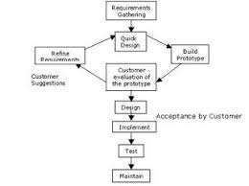
PROTOTYPE MODEL

Slide 20
PROTOTYPE MODEL
It develops working prototype of software instead of developing actual software
Prototype is usable program but not suitable as final software product
Poor Performance
Poor Maintainability
Poor Quality
Prototype is Throw Away Type Model
All requirements not given at the starting of Project, Requirement refinement takes place by customer suggestion

Slide 21
PROTOTYPE MODEL
Advantages
Used for complex models and suited for projects where requirements are hard to determine and confidence in requirement is low.
Development of prototype may include extra cost but overall cost will be less than waterfall model

Slide 22
PROTOTYPE MODEL
Disadvantages
Very much customer involvement
We avoid showing quality attribute in project just to show a prototype
Customer doesn’t know exact requirement

Slide 23
Prototyping Model
The prototype may be a usable program but is not suitable as the final software product.
The code
for the prototype is thrown away. However
experience gathered helps in developing the actual system.
The development of a prototype might involve extra cost, but overall cost might turnout to be lower than that of an equivalent system developed using the waterfall model.

Slide 24
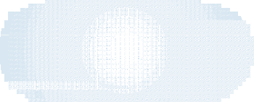
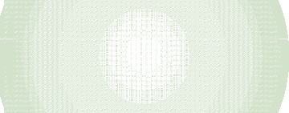



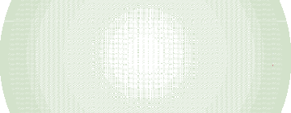
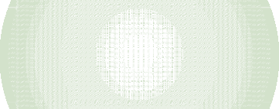

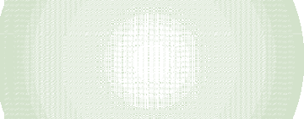
Evolutionary Process Model
Concurr ent activities
Specification
Initial version
Outline description
Development
Intermediate
versions
Validation
Final version

Slide 25
Evolutionary Process Model
Evolutionary Model are incremental characterised in a manner that enable software engineer to increasingly develop more complete version of software
Customer is not given the core module on completion. It is used only by customer when project is complete
Requirements are progressively deceived and refined with each built

Slide 26
Evolutionary Process Model
Rough Requirement Specification
Identify the Core and other Parts to be developed incrementally
Develop the core part using iterative waterfall model
Collect customer feedback and modify requirements
Develop next identical feature using an iterative waterfall model

Slide 27
Evolutionary Process Model
Advantages
Error Reduction
User Satisfaction
High Quality
Low Risk
Reduction in Cost

Slide 28
Evolutionary Process Model
Disadvantages
Several Version releases= more Effort
Dividing Software
Uncertain nature of Customer needs
Time and Cost
Confusion by several version

Slide 29
Spiral Model(By Barry Boehm(1986)
Models do not deal with uncertainly (Project Risk) which is inherent to software projects.
Important software projects have failed because project risks were neglected & nobody was prepared when something unforeseen happened.

Slide 30
Spiral Model
Cumulative Cost
Progress

Slide 31
Spiral Model
The radial dimension of the model represents the cumulative costs. Each path around the spiral is indicative of increased costs. The angular dimension represents the progress made in completing each cycle. Each loop of the spiral from X-axis clockwise through 360º represents one phase. One phase is split roughly into four sectors of major activities.
Planning: Determination of objectives, alternatives & constraints.
Risk Analysis: Analyze alternatives and attempts to identify and resolve the risks involved.
Developmentand Test: Product development and testing product.
Assessment and Planning next iteration: Customer evaluation

Slide 32
Spiral Model
An important feature of the spiral model is that each phase is completed with a review by the people concerned with the project (designers and programmers)
Advantages
The advantage of this model is the wide range of options to accommodate the good features of other life cycle models.
It become equivalent to another lifecycle model in appropriate situation
Risk Reduction: Risk Analysis at every stage of development, thus model tries to accommodate all possible risk
Dis:-Relay on risk assessment expertise

Slide 33
Spiral Model
Flexible: Functionality can be added
User can see product during life cycle
Each phase is refined with the help of prototype model
Disadvantages
The spiral model has some difficulties that need to be resolved before it can be a universally applied life cycle model. These difficulties include
Lack of explicit process guidance in determining objectives, constraints, alternatives;
Relying on risk assessment expertise;
Complex

Slide 34
Selection of a Life Cycle Model
Selection of a model is based on:
Requirements
Development team
Users
Project type and associated risk

Slide 35
Based On Characteristics Of Requirements
Requirements | Waterfall | Prototype | Iterative enhancement | Evolutionary development | Spiral
Are requirements easily understandable and defined? | Yes | No | No | No | No
Do we change requirements quite often? | No | Yes | No | No | Yes
Can we define requirements early in the cycle? | Yes | No | Yes | Yes | No
Requirements are indicating a complex system to be built | No | Yes | Yes | Yes | Yes

Slide 36
Based On Characteristics Of Requirements
Requirements | Waterfall | Prototype | Iterative enhancement | Evolutionary development | Spiral
Are requirements easily understandable and defined?
Do we change requirements quite often?
Can we define requirements early in the cycle?
Requirements are indicating a complex system to be built

Slide 37
Based On Status Of Development Team
Development team | Waterfall | Prototype | Iterative enhancement | Evolutionary development | Spiral
Less experience on similar projects?
Less domain knowledge (new to the technology)
Less experience on tools to be used
Availability of training if required

Slide 38
Based On Status Of Development Team
Development team | Waterfall | Prototype | Iterative enhancement | Evolutionary development | Spiral
Less experience on similar projects? | No | Yes | No | No | Yes
Less domain knowledge (new to the technology) | Yes | No | Yes | Yes | Yes
Less experience on tools to be used | Yes | No | No | No | Yes
Availability of training if required | No | No | Yes | Yes | No

Slide 39
Based On User’s Participation
Involvement of Users | Waterfall | Prototype | Iterative enhancement | Evolutionary development | Spiral
User involvement in all phases
Limited user participation
User have no previous experience of participation in similar projects
Users are experts of problem domain

Slide 40
Based On User’s Participation
Involvement of Users | Waterfall | Prototype | Iterative enhancement | Evolutionary development | Spiral
User involvement in all phases | No | Yes | No | No | No
Limited user participation | Yes | No | Yes | Yes | Yes
User have no previous experience of participation in similar projects | No | Yes | Yes | Yes | Yes
Users are experts of problem domain | No | Yes | Yes | Yes | No

Slide 41
Based On Type Of Project With Associated Risk
Project type and risk | Waterfall | Prototype | Iterative enhancement | Evolutionary development | Spiral
Project is the enhancement of the existing system
Funding is stable for the project
High reliability requirements
Tight project schedule
Use of reusable components
Are resources (time, money, people etc.) scare?

Slide 42
Based On Type Of Project With Associated Risk
Project type and risk | Waterfall | Prototype | Iterative enhancement | Evolutionary development | Spiral
Project is the enhancement of the existing system | No | No | Yes | Yes | No
Funding is stable for the project | Yes | Yes | No | No | No
High reliability requirements | No | No | Yes | Yes | Yes
Tight project schedule | No | Yes | Yes | Yes | Yes
Use of reusable components | No | Yes | No | No | Yes
Are resources (time, money, people etc.) scare? | No | Yes | No | No | Yes

Slide 43
Multiple Choice Questions
Note: Select most appropriate answer of the following questions:
2.1 Spiral Model was developed by
(a) Bev Littlewood
(c) Roger Pressman
(b) Berry Boehm
(d) Victor Basili
2.2 Which model is most popular for student’s small projects?
(a) Waterfall model
(c) Build and fix model
  Which is not a software life cycle model?
    Waterfall model
(c) Prototyping model
  Project risk factor is considered in
    Waterfall model
(c) Spiral model
  SDLC stands for
    Software design life cycle
(c) System development life cycle
(b) Spiral model
(d) Prototyping model
(b) Spiral model
(d) Capability maturity model
(b) Prototyping model
(d) Iterative enhancement model
(b) Software development life cycle
(d) System design life cycle

Slide 44
Multiple Choice Questions
Note: Select most appropriate answer of the following questions:
2.6 Build and fix model has
(a) 3 phases
(c) 2 phases
  SRS stands for
    Software requirements specification
(c) System requirements specification
  Waterfall model is not suitable for
    small projects
(c) complex projects
  RAD stands for
    Rapid application development
(c) Ready application development
  RAD model was proposed by
    Lucent Technologies
(c) IBM
(b) 1 phase
(d) 4 phases
(b) Software requirements solution
(d) none of the above
(b) accommodating change
(d) none of the above
(b) Relative application development
(d) Repeated application development
(b) Motorola
(d) Microsoft

Slide 45
Multiple Choice Questions
Note: Select most appropriate answer of the following questions:
2.11 If requirements are easily understandable and defined,which model is best suited?
(a) Waterfall model
(c) Spiral model
(b) Prototyping model
(d) None of the above
2.12 If requirements are frequently changing, which model is to be selected?
(a) Waterfall model
(c) RAD model
(b) Prototyping model
(d) Iterative enhancement model
2.13 If user participation is available, which model is to be chosen?
(a) Waterfall model
(c) Spiral model
(b) Iterative enhancement model
(d) RAD model
2.14 If limited user participation is available, which model is to be selected?
(a) Waterfall model
(c) Iterative enhancement model
(b) Spiral model
(d) any of the above
2.15 If project is the enhancement of existing system, which model is best suited?
(a) Waterfall model
(c) Iterative enhancement model
(b) Prototyping model
(d) Spiral model

Slide 46
Multiple Choice Questions
Note: Select most appropriate answer of the following questions:
2.16 Which one is the most important feature of spiral model?
(a) Quality management
(c) Performance management
(b) Risk management
(d) Efficiency management
2.17 Most suitable model for new technology that is not well understood is:
(a) Waterfall model
(c) Iterative enhancement model
(b) RAD model
(d) Evolutionary development model
2.18 Statistically, the maximum percentage of errors belong to the following phase of SDLC
(a) Coding
(c) Specifications
(b) Design
(d) Installation and maintenance
2.19 Which phase is not available in software life cycle?
(a) Coding
(c) Maintenance
(b) Testing
(d) Abstraction
2.20 The development is supposed to proceed linearly through the phase in
(a) Spiral model
(c) Prototyping model
(b) Waterfall model
(d) None of the above

Slide 47
Exercises
  What do you understand by the term Software Development Life Cycle (SDLC)? Why is it important to adhere to a life cycle model while developing a large software product?
  What is software life cycle? Discuss the generic waterfall model.
  List the advantages of using waterfall model instead of adhoc build and fix model.
  Discuss the prototyping model. What is the effect of designing a prototype on the overall cost of the project?
  What are the advantages of developing the prototype of a system?
  Describe the type of situations where iterative enhancement model might lead to difficulties.
  Compare iterative enhancement model and evolutionary process model.

Slide 48
Exercises
  Sketch a neat diagram of spiral model of software life cycle.
  Compare the waterfall model and the spiral model development.
of software
  As we move outward along with process flow path of the spiral model, what can we say about software that is being developed or maintained.
  How does “project risk” factor effect the spiral model of software development.
  List the advantages and disadvantages of involving a software engineer throughout the software development planning process.
  Explain the spiral model of software development. What are the limitations of such a model?
  Describe the rapid application development (RAD) model.Discuss each phase in detail.
  What are the characteristics to be considered for the selection of the life cycle model?

Slide 49
Exercises
  What is the role of user participation in the selection of a life cycle model?.
  Why do we feel that characteristics of requirements play a very
significant role in the selection of a life cycle model?
  Write short note on “status of development team” for the selection of a life cycle model?.
  Discuss the selection process parameters for a life cycle model.
  What is unified process? Explain various phases along with the outcome of each phase.
  Describe the unified process work products after each phase of unified process.
  What are the advantages of iterative approach over sequential approach? Why is unified process called as iterative or incremental?

