Slide 1
Distributed Deadlock Detection
Assumptions:
  System has only reusable resources
  Only exclusive access to resources
  Only one copy of each resource
  States of a process: running or blocked
  Running state: process has all the resources
  Blocked state: waiting on one or more resource

Slide 2
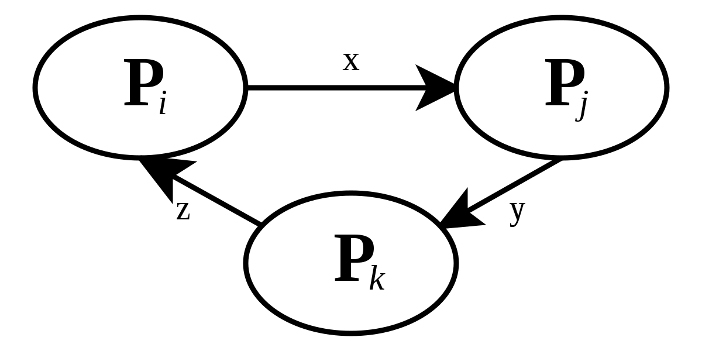
Wait for Graph (WFG)
The cycles can be seen more clearly in this form of the graph. There is deadlock in the system if and only if there exists a cycle or a knot in the wait-for-graph.

Slide 3
Deadlocks
Resource Deadlocks
  A process needs multiple resources for an activity.
  Deadlock occurs if each process in a set request resources
  held by another process in the same set, and it must receive
  all the requested resources to move further.
Communication Deadlocks
  Processes wait to communicate with other processes in a set.
  Each process in the set is waiting on another process’s
  message, and no process in the set initiates a message
  until it receives a message for which it is waiting.

Slide 4
Deadlock Handling Strategies
Deadlock Prevention: difficult
Deadlock Avoidance: before allocation, check for possible deadlocks.
  Difficult as it needs global state info in each site (that handles resources).
Deadlock Detection: Find cycles. Focus of discussion.
Deadlock detection algorithms must satisfy 2 conditions:
  No undetected deadlocks.
  No false deadlocks.

Slide 5
Issues in Deadlock Detection
Two basic issues:
  Detection of existing deadlocks
  Resolution of detected deadlocks
Detection involves two issues:
  Maintenance of the WFG
  Search of WFG for presence of cycle.
A correct deadlock detection algorithm must satisfy following two conditions:
  Progress
  Safety

Slide 6
Resolution
It involves breaking existing wait for dependencies in the WFG to resolve the deadlock
It involves rolling back one or more processes that are deadlocked and assigning their resources to the blocked processes. So they can resume execution.
As wait for dependencies broken, the corresponding information should be immediately cleaned from the system.
If don’t it may result detection of phantom deadlocks.
Phantom Deadlock: the delay in propagating local information might cause the detection algorithm to identify deadlocks that do not really exist.

Slide 7
Distributed Deadlocks
Centralized Control
  A control site constructs wait-for graphs (WFGs) and checks for directed cycles.
  WFG can be maintained continuously (or) built on-demand by requesting WFGs from individual sites.
Distributed Control
  WFG is spread over different sites.Any site can initiate the deadlock detection process.
Hierarchical Control
  Sites are arranged in a hierarchy.
  A site checks for cycles only in descendents.

Slide 8
Completely centralized algorithm
Designated site called control site.
All sites request and release resources by sending message to the control site.
When the control site receives message, it correspondingly updates its WFG.
The control site checks the WFG for deadlocks whenever a request edge is added to WFG.
It is simple and easy to implement but highly inefficient.
It results in large delays in responding to user requests.
Large communication overhead and the congestion of communication links near the control site.
Reliabilty is poor- if the control site fails, the entire sysyem comes to a halt.

Slide 9
Centralized Algorithms
Ho-Ramamoorthy 2-phase Algorithm
  Each site maintains a status table of all processes initiated at that site: includes all resources locked & all resources being waited on.
  Controller requests (periodically) the status table from each site.
  Controller then constructs WFG from these tables, searches for cycle(s).
  If no cycles, no deadlocks.
  Otherwise, (cycle exists): Request for state tables again.
  Construct WFG based only on common transactions in the 2 tables.
  If the same cycle is detected again, system is in deadlock.
  Later proved: cycles in 2 consecutive reports need not result in a deadlock. Hence, this algorithm detects false deadlocks.

Slide 10
Centralized Algorithms...
Ho-Ramamoorthy 1-phase Algorithm
  Each site maintains 2 status tables: resource status table and process status table.
  Resource table: transactions that have locked or are waiting for resources.
  Process table: resources locked by or waited on by transactions.
  Controller periodically collects these tables from each site.
  Constructs a WFG from transactions common to both the tables.
  No cycle, no deadlocks.
  A cycle means a deadlock.

Slide 11
Distributed Algorithms
Path-pushing: resource dependency information disseminated through designated paths (in the graph).
Edge-chasing: special messages or probes circulated along edges of WFG. Deadlock exists if the probe is received back by the initiator.
Diffusion computation: queries on status sent to process in WFG.
Global state detection: get a snapshot of the distributed system. Not discussed further in class.

Slide 12
Edge-Chasing Algorithm
Chandy-Misra-Haas’s Algorithm:
  A probe(i, j, k) is used by a deadlock detection process Pi. This probe is sent by the home site of Pj to Pk.
  This probe message is circulated via the edges of the graph. Probe returning to Pi implies deadlock detection.
  Terms used:
    Pj is dependent on Pk, if a sequence of Pj, Pi1,.., Pim, Pk exists.
    Pj is locally dependent on Pk, if above condition + Pj,Pk on same site.
    Each process maintains an array dependenti: dependenti(j) is true if Pi knows that Pj is dependent on it. (initially set to false for all i & j).

Slide 13
Chandy-Misra-Haas’s Algorithm
Sending the probe:
if Pi is locally dependent on itself then deadlock.
else for all Pj and Pk such that
(a) Pi is locally dependent upon Pj, and
(b) Pj is waiting on Pk, and
(c ) Pj and Pk are on different sites, send probe(i,j,k) to the home
site of Pk.
Receiving the probe:
if (d) Pk is blocked, and
(e) dependentk(i) is false, and
(f) Pk has not replied to all requests of Pj,
then begin
dependentk(i) := true;
if k = i then Pi is deadlocked
else ...

Slide 14
Chandy-Misra-Haas’s Algorithm
Receiving the probe:
…….
else for all Pm and Pn such that
(a’) Pk is locally dependent upon Pm, and
(b’) Pm is waiting on Pn, and
(c’) Pm and Pn are on different sites, send probe(i,m,n)
to the home site of Pn.
end.
Performance:
For a deadlock that spans m processes over n sites, m(n-1)/2 messages
are needed.
Size of the message 3 words.
Delay in deadlock detection O(n).

Slide 15
Hierarchical Deadlock Detection
Follows Ho-Ramamoorthy’s 1-phase algorithm. More than 1 control site
organized in hierarchical manner.
Each control site applies 1-phase algorithm to detect (intracluster) deadlocks.
Central site collects info from control sites, applies 1-phase algorithm to
detect intracluster deadlocks.
Control
site
Central Site
Control
site
Control
site

Slide 16
Persistence & Resolution
Deadlock persistence:
  Average time a deadlock exists before it is resolved.
Implication of persistence:
  Resources unavailable for this period: affects utilization
  Processes wait for this period unproductively: affects response time.
Deadlock resolution:
  Aborting at least one process/request involved in the deadlock.
  Efficient resolution of deadlock requires knowledge of all processes and resources.
  If every process detects a deadlock and tries to resolve it independently -> highly inefficient ! Several processes might be aborted.

Slide 17
Deadlock Resolution
Priorities for processes/transactions can be useful for resolution.
  Consider priorities introduced in Obermarck’s algorithm.
  Highest priority process initiates and detects deadlock (initiations by lower priority ones are suppressed).
  When deadlock is detected, lowest priority process(es) can be aborted to resolve the deadlock.
After identifying the processes/requests to be aborted,
  All resources held by the victims must be released. State of released resources restored to previous states. Released resources granted to deadlocked processes.
  All deadlock detection information concerning the victims must be removed at all the sites.

