Slide 1
1

Slide 2
Why Software Engineering ?
Change in nature & complexity of software
Concept of one “guru” is over
We all want improvement
Ready for change
2

Slide 3
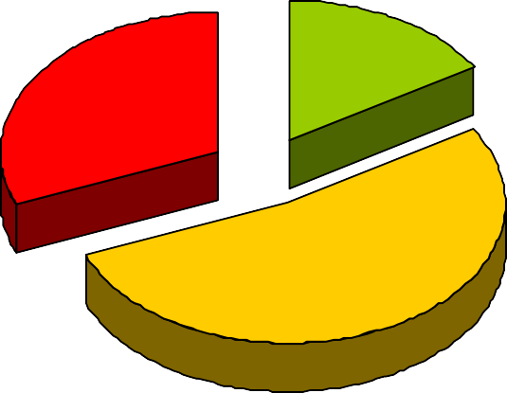
The Evolving Role of Software
Software industry is in Crisis!
success 16%
failure 31%
over budget 53%
Source: The Standish Group International, Inc. (CHAOS research)
3

Slide 4
The Evolving Role of Software
This is the SORRY state of Software Engineering Today!
Successful – 28%
Completed Late, over budget, and/or with features missing – 49%
Cancelled – 23%
Data on 28,000 projects completed in 2000
4

Slide 5
The Evolving Role of Software
As per the IBM report, “31%of the project get cancelled before they are completed, 53% over- run their cost estimates by an average of 189% and for every 100 projects, there are 94 restarts”.
5

Slide 6
The Evolving Role of Software
Hw cost Sw cost
1960
Year
1999
Relative Cost of Hardware and Software
6

Slide 7
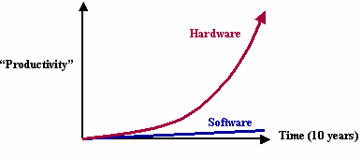
The Evolving Role of Software
Unlike Hardware
– Moore’s law: processor every two years
speed/memory
capacity
doubles
7

Slide 8
The Evolving Role of Software
Managers and Technical Persons are asked:
Why does it take so long to get the program finished?
Why are costs so high?
Why can not we find all errors before release?
Why do we have difficulty in measuring progress of software development?
8

Slide 9
Factors Contributing to the Software Crisis
Larger problems,
Lack of adequate training in software engineering,
Increasing skill shortage,
Low productivity improvements.
9

Slide 10
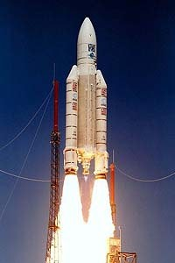
Some Software failures
Ariane 5
It took the European Space Agency 10 years and $7 billion to produce Ariane 5, a giant rocket capable of hurling a pair of three-ton satellites into orbit with each
launch and intended to give
Europe
in the
overwhelming supremacy
commercial space business.
The rocket was destroyed after 39 seconds of its launch, at an altitude of two and a half miles along with its payload of four expensive and uninsured scientific satellites.

Slide 11

Some Software failures
When the guidance system’s own computer tried to convert one piece of data the sideways velocity of the rocket from a 64 bit format to a 16 bit format; the number was too big, and an overflow error resulted after 36.7 seconds. When the guidance system shutdown, it passed control to an identical, redundant unit, which was there to provide backup in case of just such a failure. Unfortunately, the second
unit, which had failed in the
few
identical manner a
milliseconds before.

Slide 12


Some Software failures
Y2K problem:
It was simply the ignorance about the adequacy or otherwise of using only last two digits of the year.
The 4-digit date format, like 1964, was shortened to 2-digit format, like 64.

Slide 13
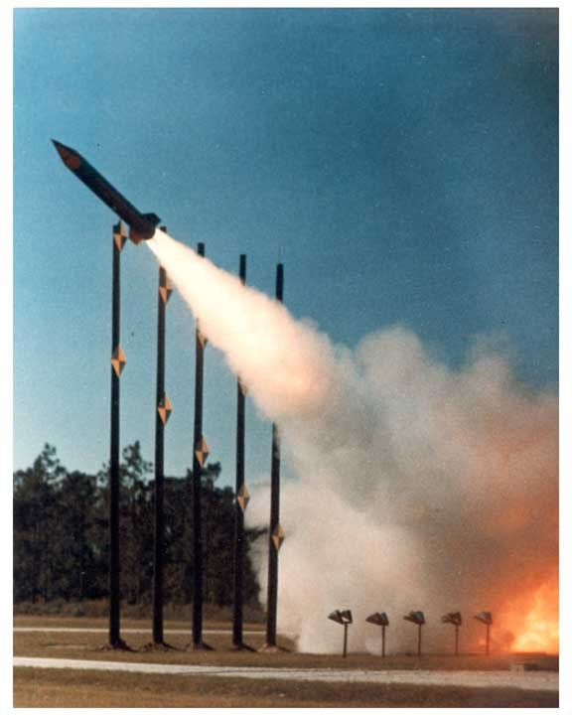
Some Software failures
The Patriot Missile
First time used in Gulf war
Used as a defense from Iraqi Scud missiles
Failed several times including one that killed 28 US soldiers in Dhahran, Saudi Arabia
Reasons:
A small timing error in the system’s clock accumulated to the point that after 14 hours, the tracking system was no longer accurate. In the Dhahran attack, the system had been operating for more than 100 hours.
Software Engineering (3rd ed.), By K.K Aggarwal & Yogesh Singh, Copyright © New Age International Publishers, 2007
13

Slide 14
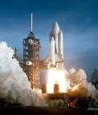
Some Software failures
The Space Shuttle
Part of an abort scenario for the Shuttle requires fuel dumps to lighten the spacecraft. It was during the second of these dumps that a (software) crash occurred.
...the fuel management module, which had performed one dump and successfully exited, restarted when recalled for the second fuel dump...

Slide 15
Some Software failures
A simple fix took care of the problem…but the programmers decided to see if they could come up with a systematic way to eliminate these generic sorts of bugs in the future. A random group of programmers applied this system to the fuel dump module and other modules.
Seventeen additional, previously unknown problems surfaced!

Slide 16
Some Software failures
Financial Software
Many companies have experienced failures in their accounting system due to faults in the software itself. The failures range from producing the wrong information to the whole system crashing.

Slide 17
Some Software failures
Windows XP
Microsoft released Windows XP on October 25, 2001.
On the
same day company posted 18 MB of
compatibility patches on the website for bug fixes, compatibility updates, and enhancements.
o Two patches fixed important security holes.
This is Software Engineering.

Slide 18

“No Silver Bullet”
The hardware cost continues to decline drastically.
However, there are desperate cries for a silver bullet something to make software costs drop as rapidly as computer hardware costs do.
But as we look to the horizon of a decade, we see no silver bullet. There is no single
development, either management
in technology or in
technique,
that by
itself
promises even one order of magnitude improvement in productivity, in reliability and in simplicity.

Slide 19
“No Silver Bullet”
The hard part of building software is the specification, design and testing of this conceptual construct, not the labour of representing it and testing the correctness of representation.
We still make syntax errors, to be sure, but they are trivial as compared to the conceptual errors (logic errors) in most systems. That is why, building software is always hard and there is inherently no silver bullet.
While there is no royal road, there is a path forward. Is reusability (and open source) the new silver bullet?

Slide 20
“No Silver Bullet”
The blame for software bugs belongs to:
Software companies
Software developers
Legal system
Universities

Slide 21


What is software?
Computer programs documentation
and associated

Slide 22
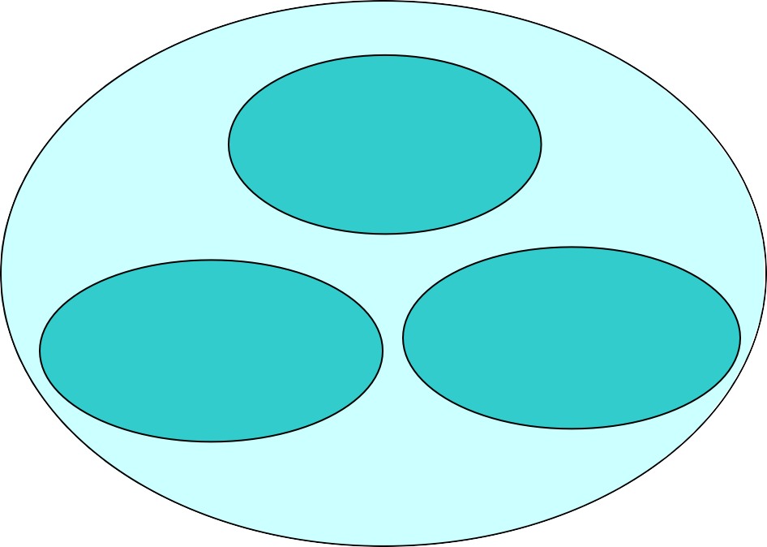
What is software?
Programs
Documentation
Operating Procedures
Software=Program+Documentation+Operating Procedures Components of software

Slide 23
Documentation consists of different types of manuals are
Formal Specification Context-
Diagram
Data Flow Diagrams
Flow Charts
Entity-Relationship Diagram
Analysis
/Specification
Design
Documentation Manuals
Source Code Listings
Cross-Reference Listing
Test Data
Test Results
Implementation
Testing
List of documentation manuals

Slide 24
Documentation consists of different types of manuals are
System Overview
User Manuals
Beginner’s Guide Tutorial
Reference Guide
Operating Procedures
Installation Guide
Operational Manuals
System
Administration Guide
List of operating procedure manuals.

Slide 25
Software Product
Software products may be developed for a particular customer or may be developed for a general market
Software products may be
–Generic - developed to be customers
sold to a range of different
–Bespoke (custom) - developed for a single customer according to their specification

Slide 26
Software Product
Software product is a product designated for delivery to the user
s_{s}o_{o}u_{u}r_{r}c_{c}e_{e} c_{c}o_{o}d_{d}e_{e}s_{s}
d_{d}o_{o}c_{c}u_{u}m_{m}e_{e}n_{n}t_{t}s_{s}
r_{r}e_{e}p_{p}o_{o}r_{r}t_{t}s_{s}
m_{m}a_{a}n_{n}u_{u}a_{a}l_{l}s_{s}
o_{o}b_{b}j_{j}e_{e}c_{c}t_{t} c_{c}o_{o}d_{d}e_{e}s_{s}
plans
plans
d_{d}a_{a}t_{t}a_{a}
t_{t}e_{e}s_{s}t_{t}s_{s}u_{u}i_{i}t_{t}e_{e}s_{s}
t_{t}e_{e}s_{s}t_{t}r_{r}e_{e}s_{s}u_{u}l_{l}t_{t}s_{s}
prototypes
prototypes

Slide 27

What is software engineering?
Software engineering is an engineering discipline which is concerned with all aspects of software production
Software engineers should
adopt a systematic and organised approach to their work
use appropriate tools and techniques depending on
  the problem to be solved,
  the development constraints and
use the resources available

Slide 28
What is software engineering?
At the first conference on software engineering in 1968, Fritz Bauer defined software engineering as “The establishment and use of sound engineering principles in order to obtain economically developed software that is reliable and works efficiently on real machines”.
Stephen Schach defined the same as “A discipline whose aim is the production of quality software, software that is delivered on time, within budget, and that satisfies its requirements”.
Both the definitions are popular and acceptable to majority. However, due to increase in cost of maintaining software, objective is now shifting to produce quality software that is maintainable, delivered on time, within budget, and also satisfies its requirements.

Slide 29
Software Process
The software process is the way in which we produce software.
Why is it difficult to improve software process ?
Not enough time
Lack of knowledge

Slide 30
Software Process
Wrong motivations
Insufficient commitment
Process improvement begins
Improved future state
Initial state
state
Productivity
Do not quit here!
Learning curve
Time

Slide 31
Software Characteristics:
Software does not wear out.
Burn-in phase
Wear out phase
Failure Intensity
Useful life phase
Time

Slide 32
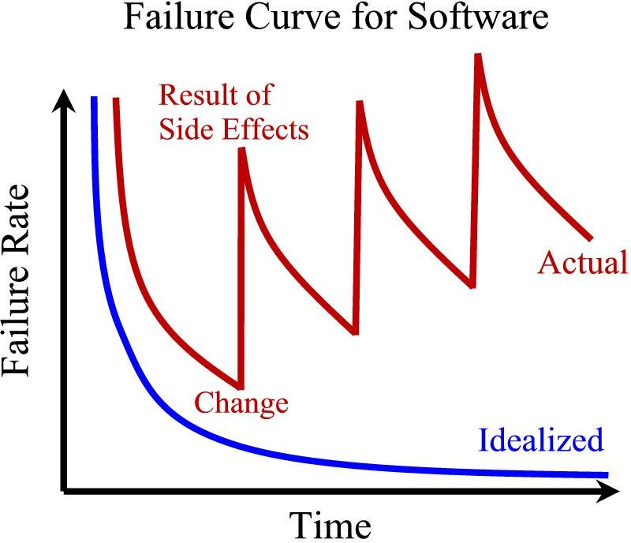
Software Characteristics:
Software is not manufactured
Reusability of components
Software is flexible

Slide 33
Software Characteristics:
Comparison of constructing a bridge vis-à-vis writing a program.
Sr. No | Constructing a bridge | Writing a program
1. | The problem is well understood | Only some parts of the problem are understood, others are not
2. | There are many existing bridges | Every program is different and designed for special applications.
3. | The requirement for a bridge typically do not change much during construction | Requirements typically change during all phases of development.
4. | The strength and stability of a bridge can be calculated with reasonable precision | Not possible to calculate correctness of a program with existing methods.
5. | When a bridge collapses, there is a detailed investigation and report | When a program fails, the reasons are often unavailable or even deliberately concealed.
6. | Engineers have been constructing bridges for thousands of years | Developers have been writing programs for 50 years or so.
7. | Materials (wood, stone,iron, steel) and techniques (making joints in wood, carving stone, casting iron) change slowly. | Hardware and software changes rapidly.

Slide 34
The Changing Nature of Software
System Software
Real Time Software
Engineering and Scientific Software
Embedded Software
Web based Software
Business Software
Artificial Intelligence Software
Personal Computer Software

Slide 35
The Changing Nature of Software
Trend has emerged to provide source code to the customer and organizations.
Software where source codes are available are known as open source software.
Examples
Open source software: LINUX, MySQL, PHP, Open office, Apache webserver etc.

Slide 36
Software Myths (Management Perspectives)
Management may be confident about good standards and clear procedures of the company.
But the taste of any food item is in the eating;
not in the Recipe !

Slide 37
Software Myths (Management Perspectives)
Company has latest computers and state-of- the-art software tools, so we shouldn’t worry about the quality of the product.
The infrastructure is only one of the several factors
that determine the quality of the product!

Slide 38
Software Myths (Management Perspectives)
Addition of more software specialists, those with higher skills and longer experience may bring the schedule back on the track!
Unfortunately,
that may further delay the schedule!

Slide 39
Software Myths (Management Perspectives)
Software is easy to change
The reality is totally different.

Slide 40
Software Myths (Management Perspectives)
Computers provide greater reliability than the devices they replace
This is not always true.

Slide 41
Software Myths (Customer Perspectives)
A general statement of objectives is sufficient to get started with the development of software. Missing/vague requirements can easily be incorporated/detailed out as they get concretized.
If we do so, we are heading towards a disaster.

Slide 42
Software Myths (Customer Perspectives)
Software software
with
more
features
is better
Software can work right the first time
Both are only myths!

Slide 43
Software Myths (Developer Perspectives)
Once the software is demonstrated, the job is done.
Usually, the problems just begin!

Slide 44
Software Myths (Developer Perspectives)
Software testing.
quality
can not be assessed
before
However, quality assessment techniques should be used through out the software development life cycle.

Slide 45
Software Myths (Developer Perspectives)
The only deliverable for a software development project is the tested code.
Tested code is only one of the deliverable!

Slide 46
Software Myths (Developer Perspectives)
Aim is to develop working programs
Those days are over. Now objective is to develop good quality maintainable programs!

Slide 47
Some Terminologies
Deliverables and Milestones
Different deliverables are generated during software development. The examples are source code, user manuals, operating procedure manuals etc.
The milestones are the events that are used to ascertain the status of the project. Finalization of specification is a milestone. Completion of design documentation is another milestone. The milestones are essential for project planning and management.

Slide 48
Some Terminologies
Product and Process
Product: What is delivered to the customer, is called a product. It may include source code, specification document, manuals, documentation etc. Basically, it is nothing but a set of deliverables only.
Process: Process is the way in which we produce software. It is the collection of activities that leads to (a part of) a product. An efficient process is required to produce good quality products.
If the process is weak, the end product will undoubtedly suffer, but an obsessive over reliance on process is also dangerous.

Slide 49
Some Terminologies
Measures, Metrics and Measurement
A measure provides a quantitative indication of the extent, dimension, size, capacity, efficiency, productivity or reliability of some attributes of a product or process.
Measurement is the act of evaluating a measure.
A metric is a quantitative measure of the degree to which a system, component or process possesses a given attribute.

Slide 50
Some Terminologies
Software Process and Product Metrics
Process metrics
quantify the attributes of software development
process and environment;
whereas product metrics are measures for the software product.
Examples
Process metrics: Productivity, Quality, Efficiency etc. Product metrics: Size, Reliability, Complexity etc.

Slide 51
Some Terminologies
Productivity and Effort
Productivity is defined as the rate of output, or production per unit of effort, i.e. the output achieved with regard to the time taken but irrespective of the cost incurred.
Hence most appropriate unit of effort is Person Months (PMs), meaning thereby number of persons involved for specified months. So, productivity may be measured as LOC/PM (lines of code produced/person month)

Slide 52
Some Terminologies
Module and Software Components
There are many definitions of the term module. They range from “a module is a FORTRAN subroutine” to “a module is an Ada Package”, to “Procedures and functions of PASCAL and C”, to “C++ Java classes” to “Java packages” to “a module is a work assignment for an individual developer”. All these definition are correct. The term subprogram is also used sometimes in place of module.

Slide 53
Some Terminologies
“An independently deliverable piece of functionality providing access to its services through interfaces”.
“A component represents a modular, deployable, and replaceable part of a system that encapsulates implementation and exposes a set of interfaces”.

Slide 54
Some Terminologies
Generic and Customized Software Products
Generic products are developed for anonymous customers. The target is generally the entire world and many copies are expected to be sold. Infrastructure software like operating system, compilers, analyzers, word processors, CASE tools etc. are covered in this category.
The customized products are developed for particular customers. The specific product is designed and developed as per customer requirements. Most of the development projects (say about 80%)come under this category.

Slide 55
Role of Management in Software Development
Factors
People
Project
Product
Process

Slide 56
Role of Management in Software Development
People
1
Dependency ₂
Order
Project
4
Product
3
Process

Slide 57
Multiple Choice Questions
Note: Select most appropriate answer of the following questions:
1.1 Software is
(a) Superset of programs
(c) Set of programs
(b) subset of programs
(d) none of the above
1.2 Which is NOT the part of operating procedure manuals?
(a) User manuals
(c) Documentation manuals
  Which is NOT a software characteristic?
    Software does not wear out
(c) Software is not manufactured
  Product is
    Deliverables
(c) Organization's effort in development
(b) Operational manuals
(d) Installation manuals
(b) Software is flexible
(d) Software is always correct
(b) User expectations
(d) none of the above
1.5 To produce a good quality product, process should be
(a) Complex
(c) Rigorous
(b) Efficient
(d) none of the above

Slide 58
Multiple Choice Questions
Note: Select most appropriate answer of the following questions:
1.6 Which is not a product metric?
(a) Size
(c) Productivity
  Which is NOT a process metric?
    Productivity
(c) Quality
  Effort is measured in terms of:
    Person-months
(c) Persons
  UML stands for
    Uniform modeling language
(c) Unit modeling language
(b) Reliability
(d) Functionality
(b) Functionality
(d) Efficiency
(b) Rupees
(d) Months
(b) Unified modeling language
(d) Universal modeling language
  An independently deliverable piece of functionality providing access to its services through interface is called
    Software measurement (b) Software composition
(c) Software measure
(d) Software component

Slide 59
Multiple Choice Questions
Note: Select most appropriate answer of the following questions:
1.11 Infrastructure software are covered under
(a) Generic products
(c) Generic and Customized products
(b) Customized products
(d) none of the above
1.12 Management of software development is dependent on
(a) people
(c) process
(b) product
(d) all of the above
1.13 During software development, which factor is most crucial?
(a) People
(c) Process
  Program is
    subset of software
(c) software
  Milestones are used to
    know the cost of the project
(c) know user expectations
(b) Product
(d) Project
(b) super set of software
(d) none of the above
(b) know the status of the project
(d) none of the above
59

Slide 60
Multiple Choice Questions
Note: Select most appropriate answer of the following questions:
1.16 The term module used during design phase refers to
(a) Function
(c) Sub program
(b) Procedure
(d) All of the above
  Software consists of
    Set of instructions + operating system
    Programs + documentation + operating procedures
    Programs + hardware manuals (d) Set of programs
  Software engineering approach is used to achieve:
(a) Better performance of hardware
(c) Reusable software
(b) Error free software
(d) Quality software product
1.19 Concept of software engineering are applicable to
(a) Fortran language only
(c) ‘C’ language only
1.20 CASE Tool is
(b) Pascal language only
(d) All of the above
(a) Computer Aided Software Engineering (b) Component Aided Software Engineering
(c) Constructive Aided Software Engineering (d)Computer Analysis Software Engineering

Slide 61
Exercises
  Why is primary goal of software development now shifting from producing good quality software to good quality maintainable software?
  List the reasons for the “software crisis”?Why are CASE tools not normally able to control it?
  “The software crisis is aggravated by the progress in hardware technology?” Explain with examples.
  What is software crisis? Was Y2K a software crisis?
  What is the significance of software crisis in reference to software engineering discipline.
  How are software myths affecting software process? Explain with the help of examples.
  State the difference between program and software. Why have documents and documentation become very important.
  What is software engineering? Is it an art, craft or a science? Discuss.

Slide 62
Exercises
  What is aim of software engineering? What does the discipline of software engineering discuss?
  Define the term “Software engineering”. Explain the major differences between software engineering and other traditional engineering disciplines.
  What is software process? Why is it difficult to improve it?
  Describe the characteristics of software contrasting it with the characteristics of hardware.
  Write down the major characteristics of a software. Illustrate with a diagram that the software does not wear out.
  What are the components of a software? Discuss how a software differs from a program.
  Discuss major areas of the applications of the software.
  Is software a product or process? Justify your answer with example

Slide 63
Exercises
1.17 Differentiate between the following
(i) Deliverables and milestones
(iii) Measures, metrics and measurement
(ii) Product and process
  What is software metric? How is it different from software measurement
  Discuss software process and product metrics with the help of examples.
  What is productivity? How is it related to effort. What is the unit of effort.
  Differentiate between module and software component.
  Distinguish between generic and customized software products. Which one has larger share of market and why?
  Is software a product or process? Justify your answer with example

Slide 64
Exercises
  Describe the role of management in software development with the help of examples.
  What are various factors of management dependency in software development. Discuss each factor in detail.
  What is more important: Product or process? Justify your answer.

